Slide 1
Sql subqueries
Continuous staff improvement project
Yurii Hohan

Slide 2
Introduction
Single Row Subqueries
Multiple Rows Subqueries
CorrelatEd Subqueries
Using operator IN
Using operator EXISTS
Using operators ANY, ALL.
Case Keyword
Relational Division

Slide 3
Subquery types By number of rows returned
Single row query. A single row subquery returns zero or one row to the outer SQL statement. You can place a subquery in a WHERE clause, a HAVING clause, Select Projection and use it in FROM (Select from single row table).
Multiple row query. A multiple row subquery returns zero, one or more rows to the outer SQL statement. You can combine such subqueries using JOIN, IN, EXISTS, ANY, SOME, ALL, CASE keyword and others.

Slide 4
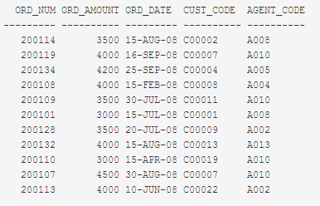
Single Row subqueries in WHERE clause
Example. The following query selects order number, amount, date, customer code and agent code for orders which have amount higher than one made on the 20th of April 2008:
SELECT ord_num,ord_amount,ord_date,cust_code, agent_code
FROM orders
WHERE ord_amount>
(SELECT AVG(ord_amount)
FROM orders
WHERE ord_date='20-APR-08');

Slide 5

Single Row subqueries in having clause
Example. The following query selects agent code, the average amount of sold items in an order and number of sales for agents who have sold more in average when agent with code A008:
SELECT AVG(ord_amount),COUNT(agent_code),agent_code
FROM orders
GROUP BY agent_code
HAVING AVG(ord_amount)>
(SELECT AVG(ord_amount)
FROM orders
WHERE agent_code='A008');

Slide 6
Subquery types By Execution
Inline subquery. Can be executed by selecting the inner scope of the query and hitting <Execute>.
Correlated subquery (also known as a synchronized subquery) is a subquery (a query nested inside another query) that uses values from the outer query. The subquery is evaluated once for each row processed by the outer query.

Slide 7
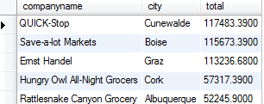
SQL correlated subquery in the SELECT clause
Example. The following query selects Name, City and Statistics of top five customers by sales:
SELECT TOP 5 companyname, city,
(SELECT
SUM(unitprice * quantity)
FROM
orders
INNER JOIN
orderdetails ON orderdetails.orderid = orders.orderid
WHERE
orders.customerid = customers.customerid) AS total
FROM
customers
ORDER BY total DESC

Slide 8

SQL correlated subquery in the WHERe clause
Example. The following query selects CompanyNames and Cities of those customers who have total sales more than 100K
SELECT companyname, city
FROM customers
WHERE
100000 < (
SELECT
SUM(unitprice * quantity)
FROM
orders
INNER JOIN
orderdetails ON orderdetails.orderid = orders.orderid
WHERE
orders.customerid = customers.customerid);

Slide 9
Subqueries with IN
Using IN we can see if a given value is in a set of values.
NOT IN checks to see if a given value is not in the set
The set can be given explicitly or from a subquery
The result of a subquery introduced with IN (or with NOT IN) is a list of zero or more values.
Only one column.
After the subquery returns results, the outer query makes use of them.
A join can always be expressed as a subquery. A subquery can often, but not always, be expressed as a join (especially if in clause contains primary or foreign keys).

Slide 10
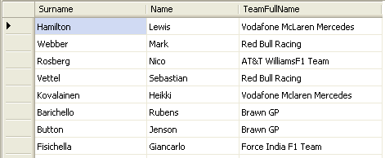
Subqueries with IN
Example. Write a query returning Name, Surname and Team Name of those pilots who race for teams with headquarters in UK.
SELECT Surname, Name, TeamFullName
FROM Pilots
WHERE TeamFullName IN
(SELECT FullName
FROM Teams
WHERE (Location LIKE '%UK%'))

Slide 11

Subqueries with IN
Example. Write a query returning Name and Surname of those pilots who won on tracks which have debuted in 21st century.
SELECT Surname,
Name
FROM Pilots
WHERE IDPilot IN (SELECT DISTINCT PastWinners.IdPilot
FROM PastWinners
INNER JOIN
RaceTracks
ON
PastWinners.TrackName = RaceTracks.TrackName
WHERE (RaceTracks.DebuteYear BETWEEN 2000 AND 2100));

Slide 12
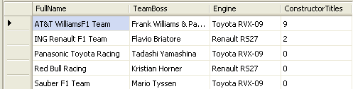
Subqueries with Not IN
Example. Write a query returning Names of Teams who are not using Ferrari or Mclaren engines.
SELECT FullName, TeamBoss, Engine, ConstructorTitles
FROM Teams
WHERE (Engine NOT IN ('Mercedes-Benz FO 108W', 'Ferrari Type 056'))

Slide 13
Subqueries with Exists
Using EXISTS we see if there is at least one element in a set
NOT EXISTS is true if the set is empty
The set is always given by a subquery
EXISTS subquery
, where subquery is a restricted SELECT statement. The INTO keyword is not allowed.

Slide 14
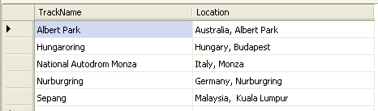
Subqueries with Exists
Example. Write a query returning track name and location of those race tracks where Grand Prix took place in 2009
SELECT TrackName, Location
FROM RaceTracks
WHERE EXISTS
(SELECT Year
FROM PastWinners
WHERE (Year = 2009) AND (RaceTracks.TrackName = TrackName))

Slide 15
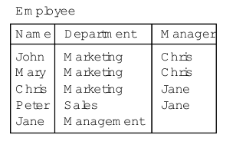

Subqueries with Exists
Example. Write a name, department and manager of each manager
SELECT E2.Name, E2.Department, E2.Manager
FROM Employee AS E2
WHERE EXISTS (SELECT *
FROM Employee AS E1
WHERE E2.Name = E1.Manager);

Slide 16
Subqueries with All/ANY
ANY and ALL compare a single value to a set of values
They are used with comparison operators like =, >, <>, >=, <=
val = ANY (set) is true if there is at least one member of the set equal to the value.
val = ALL (set) is true if all members of the set are equal to the value.

Slide 17

Subqueries with ANY
Example. Write a query returning surname, name and year of triumph of all Grand-Prix Australia winners.
SELECT Surname,
Name,
(SELECT Top 1 Year
FROM PastWinners
WHERE (TrackName = 'Albert Park')
AND (Pilots.IDPilot = IdPilot)) AS Year
FROM Pilots
WHERE IDPilot = ANY (SELECT IdPilot
FROM PastWinners AS PastWinners_1
WHERE (TrackName = 'Albert Park'))
ORDER BY Surname, Name;

Slide 18
Subqueries with All
Example. Write a query returning info about the team with the most trophies won in F1 history
SELECT FullName, Location, ConstructorTitles, Wins
FROM Teams
WHERE ConstructorTitles >= ALL
(SELECT ConstructorTitles
FROM Teams AS Teams_1);

Slide 19
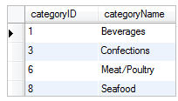
SQL correlated subquery in HAVING clause
Example. The following query selects category Id and Name for those categories where there is a product whose max price is greater than two average prices of all products within the category.
SELECT t1.categoryID, categoryName
FROM products t1
INNER JOIN
categories c ON c.categoryID = t1.categoryID
GROUP BY categoryID, categoryName
HAVING MAX(unitprice) > ALL (
SELECT 2 * AVG(unitprice)
FROM
products t2
WHERE
t1.categoryID = t2.categoryID)

Slide 20
CASE Expression
CASE is the special scalar expression in SQL language. CASE expression is widely used to facilitate determining / setting a new value from user input values. CASE expression can be used for various purposes which depends on the business logic.
CASE expression is mostly used in SQL stored procedure or as a formula for a particular column, which optimizes the SQL statements.

Slide 21
Syntax of CASE Expression
SQL CASE expression is used as a type of IF-THEN-ELSE statement. It is similar to switch statement in recent programming languages such as C# and Java. The syntax of the CASE statement is simple as follows:
CASE column_name
WHEN condition1 THEN result1
WHEN condition2 THEN result2
...
ELSE result
END

Slide 22
Case Example
Example. Write a query that returns store name, sales for new season according to formula (increase by 100% for LA stores and by 50% for San Diego stores) and Tax_Date:
SELECT Store_Name,
CASE Store_Name
WHEN 'Los Angeles' THEN Sales * 2
WHEN 'San Diego' THEN Sales * 1.5 ELSE Sales
END AS "New Sales",
Tax_Date
FROM Store_Information;
Store_Name | New Sales | Tax_Date
Los Angeles | 3000 | Jan-05-1999
San Diego | 375 | Jan-07-1999
San Francisco | 300 | Jan-08-1999
Boston | 700 | Jan-08-1999

Slide 23
Case Example
Example. Write a query that returns store name, date and whether the sales went well that day
SELECT Store_Name,
Sales_Date,
CASE
WHEN Sales >= 1000 THEN 'Good Day'
WHEN Sales >= 500 THEN 'OK Day' ELSE 'Bad Day'
END AS "Sales Status"
FROM Store_Information;
Store Name | Sales_Date | Sales_Status
Los Angeles | Jan-05-1999 | Good Day
San Diego | Jan-07-1999 | Bad Day
San Francisco | Jan-08-1999 | Bad Day
Boston | Jan-08-1999 | OK Day

Slide 24
Case Example
Example. Write a query that returns store name, date and whether the sales went well that day
SELECT Store_Name,
Sales_Date,
CASE
WHEN Sales >= 1000 THEN 'Good Day'
WHEN Sales >= 500 THEN 'OK Day' ELSE 'Bad Day'
END AS "Sales Status"
FROM Store_Information;
Store Name | Sales_Date | Sales_Status
Los Angeles | Jan-05-1999 | Good Day
San Diego | Jan-07-1999 | Bad Day
San Francisco | Jan-08-1999 | Bad Day
Boston | Jan-08-1999 | OK Day

Slide 25
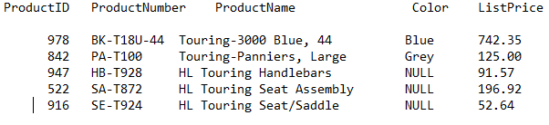
Case Example + Sorting
Example. Write a query that returns Product info with products sorted by color or by name if color is not specified and then by ProductNumber
SELECT ProductID,
ProductNumber,
Name AS ProductName,
Color,
ListPrice
FROM Production.Product
ORDER BY CASE
WHEN Color IS NULL THEN Name
ELSE Color
END, ProductNumber DESC;

Slide 26
Case Example + Aggregate Functions
Example. Write a query that number of males and females from Personal Data of the company.
SELECT count(CASE WHEN SEX = 'M' THEN 1 END) AS MALES,
count(CASE WHEN SEX = 'F' THEN 1 END) AS FEMALES
FROM PERSONAL_DATA;
MALES | FEMALES
10004 | 20421

Slide 27
Relational Division
Relational division is a binary operation involving two sets, R and S.
The operation can be written just like a mathematical division—that is, R ÷ S. Set R should have at least two attributes, A1 and A2.
The result, Q will be a set of values from A1 in set R for which there’s a corresponding A2 value to match every row in set S
The relational division operator is effectively the opposite of the Cartesian product operator. R ÷ S = Q, Q x S = R

Slide 28
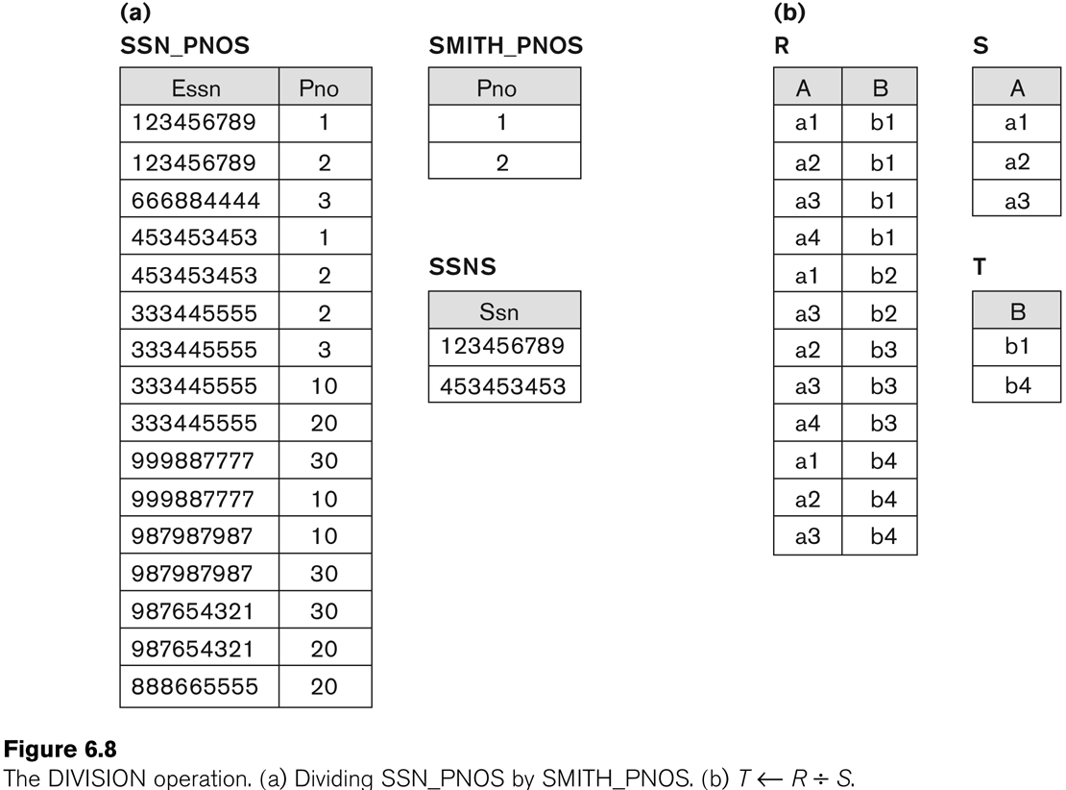
Relational Division

Slide 29
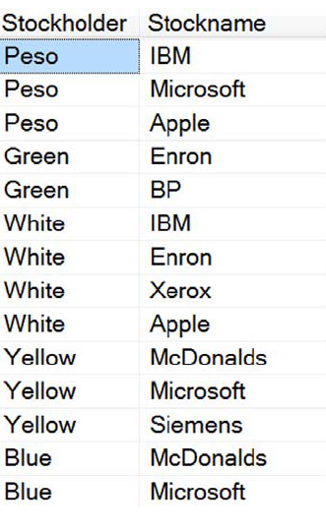
Relational Division. Solution 1
-- Query 1
SELECT sh.Stockholder
FROM dbo.Stockholders AS sh
WHERE sh.Stockname IN ('McDonalds', 'Microsoft')
GROUP BY sh.Stockholder
HAVING COUNT(sh.Stockname) = 2
AND COUNT(sh.Stockname) = (SELECT COUNT(*)
FROM dbo.Stockholders AS x
WHERE
x.Stockholder = sh.Stockholder);

Slide 30
Relational Division. Solution 2
SELECT Stockholder
FROM dbo.Stockholders
GROUP BY Stockholder
HAVING SUM(CASE
WHEN Stockname IN ('McDonalds', 'Microsoft')
THEN 1
ELSE 0 END)
>= 2
AND MIN(CASE
WHEN Stockname IN ('McDonalds', 'Microsoft')
THEN 1
ELSE 0 END) = 1;
The second clause is added to satisfy exact division.

Slide 31
Assignment
Write three correlated Subqueries: one in Select, one in Where and onE in Having.
Combine queries using in, Exists, Any, All (one query each).
Write one query using case in select.
Write one query using Relational Division.
Write comment explaining Query before it.

